Slide 1
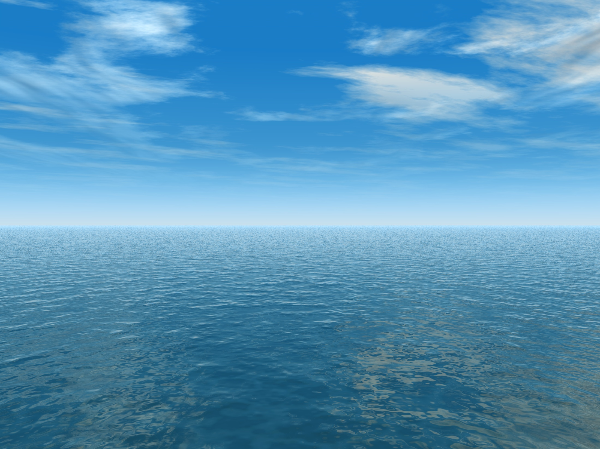


THE AQUANTIS OCEAN-CURRENT TURBINE
RENEWABLE ENERGY FROM MARINE CURRENTS
Aquantis Preliminary Design Review (PDR)
October 18 & 19, 2011
Platform Hydrodynamic Stability
Rich Banko, Dave Coakley, Dana Colegrove
Naval Surface warfare Center, Carderock Div. (NSWCCD)
richard.banko@navy.mil
301-227-1811
Company Confidential and Proprietary

Slide 2
Top Level Requirements
8c/kWh
Reliability
Energy Production
Installation and Maintenance
Site Aspects
R1
Design life: 20 years
R2
Maintenance interval: 5 years
E1
C-Plane Rated Output: 3.2MW
E2
Target capacity factor: 65%
I1
Towable to site
I2
Net buoyancy: 1750 kN
R3
Dry environment inside nacelle
S1
Operating depth range: 70-200m
S2
Crush depth: 305m
E3
Rated current speed: 1.6m/s
I3
Pitch angle for towing and operation: 0°
C1
Components within CAPEX budget
Derived Requirements
Blades
Wing/Truss
Hydraulics
Stability
Rotor Hub
Moorings
Generator
Brake
Nacelle
Grid Connection
Bearing and seal
Heat Exchanger

Slide 3
System Loading
Installation
Towing C-Plane to site
Lowering C-Plane to operating depth
Operation
Fatigue cycles: 210 million blade passing cycles
Braking at 2m/s
Raising C-Plane to Surface
100-year return environmental loads
Accidental
Failure of one mooring line
Failure of anchor
Hydraulic failure
Electrical failure

Slide 4
Derived Requirements – Stability / Transport and Installation
C1
Components within CAPEX budget
Installation target cost: $285,000
I3
Pitch angle for towing and operation: 0°
Towing arrangement to be designed accordingly
R1
Design life: 20 years
Accelerations during transportation limited by internal equipment and structures
Accelerations during operation limited by internal equipment and structures
C-Plane should not be inverted at any time
TLR

Slide 5
Derived Requirements – Wing/Truss
C1
Components within CAPEX budget
Wing/Truss target cost: $1,500,000
R1
Design life: 20 years
Extreme flow velocity: 1.8m/s
Extreme flow shear: 0.01mps/m
100-year return wave loading
210 million wing pass cycles per rotor
R2
Maintenance interval: 5 years
Wing/Truss shall require no maintenance in 5 year intervals
TLR

Slide 6
Derived Requirements – Wing/Truss
I2
Net buoyancy: 1750 kN
Wing/Truss target buoyancy: 1,150kN
I3
Pitch angle for towing and operation: 0°
Wing/Truss shall maintain level position at 0m/s to 1.6m/s
Wing/Truss shall drive C-Plane down at speeds over 1.6m/s
TLR

Slide 7
Purpose, Objectives, & Integration
Nacelle Support Structure
  The Support Structure (whether Wing-shaped or Truss-shaped) structural support for the four (4) nacelles along the span and provides the structural and hydrostatic locations of the mooring points for the vertical and forward mooring lines.
  The Support Structure can provide various nacelle/rotor mounting configurations such as 4-Downwind (DW) rotors, 4-Upwind (UW) rotors or a 2-DW & 2-UW configuration. Each configuration has its unique set of advantages and disadvantages and effects the rotor structural and performance parameters.
  The Support Structure should be of minimum weight with the capability to provide the necessary structural rigidity for all load cases (static and dynamic) and provide the required net buoyancy at a cost that is within expected target costs.

Slide 8
Purpose, Objectives, & Integration
Nacelle Support Structure
  The Support Structure (whether Wing-shaped or Truss-shaped) structural support for the four (4) nacelles along the span and provides the structural and hydrostatic locations of the mooring points for the vertical and forward mooring lines.
  The Support Structure can provide various nacelle/rotor mounting configurations such as 4-Downwind (DW) rotors, 4-Upwind (UW) rotors or a 2-DW & 2-UW configuration. Each configuration has its unique set of advantages and disadvantages and effects the rotor structural and performance parameters.
  The Support Structure should be of minimum weight with the capability to provide the necessary structural rigidity for all load cases (static and dynamic) and provide the required net buoyancy at a cost that is within expected target costs.

Slide 9
Purpose, Objectives, & Integration
Nacelle Support Structure
  The Support Structure (whether Wing-shaped or Truss-shaped) structural support for the four (4) nacelles along the span and provides the structural and hydrostatic locations of the mooring points for the vertical and forward mooring lines.
  The Support Structure can provide various nacelle/rotor mounting configurations such as 4-Downwind (DW) rotors, 4-Upwind (UW) rotors or a 2-DW & 2-UW configuration. Each configuration has its unique set of advantages and disadvantages and effects the rotor structural and performance parameters.
  The Support Structure should be of minimum weight with the capability to provide the necessary structural rigidity for all load cases (static and dynamic) and provide the required net buoyancy at a cost that is within expected target costs.

Slide 10
Technical Approach
Platform Static & Hydrodynamic Stability
Key issues that effect platform stability and the nacelle Support Structure
  Weights and centers (gravity and buoyancy) of the major components being separated by a substantial distance causing a tail heavy situation (for DW rotors)
  Weights and centers locations causing large torsional moments and possible large angular deflections of the Support Structure for 4-DW and 4-UW configurations
  Weights and centers locations causing adverse in-water hang angles for 4-DW and 4-UW rotor configurations
  Vertical mooring line requirement placed a distance aft of the confluence point for the forward mooring lines in the 2-DW/2-UW configuration causes adverse roll/yaw motions from off-axis currents
  The wake, turbulence and vortex shed from the tubular members of the Truss-shaped Support Structure forward of downwind rotor blades could cause fatigue problems in 4-DW and 2-DW/2_UW configurations

Slide 11
Platform Stability
Static Stability
Static stability refers to the ability to react to static (weight & buoyancy) and steady hydrodynamic forces (rotor & structure) induced on the platform to seek a neutral and balanced attitude not resulting in increasing forces and moments
Two planes of static stability to consider:
  Vertical or pitch plane (forces in the x and z-directions, moments about the y-axis)
  Lateral or yaw/roll plane (forces in the y direction, moments in the x and z-directions)

Slide 12
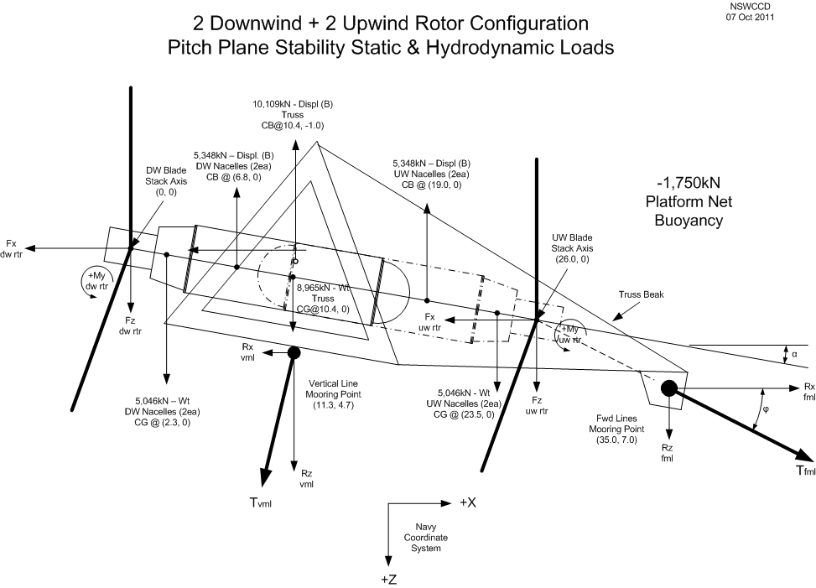
Platform Stability
Pitch Plane Free-Body Diagram
Sum of the Moments about Mooring Point Y-axis = 0

Slide 13
Platform Stability
ARL WTPERF Output file for 40m_950kW_2-blade Rotor_TSR 10
Rotor thrust (drag) used for pitch plane stability analysis

Slide 14
Rotor Forces
40m_950kW_2-blade Rotor_TSR 10
Rotor Thrust/Drag, Fx (kN)
Rotor Torque, Mx (kN-m)
Flow Velocity (m/s)
Flow Velocity (m/s)

Slide 15
Platform Stability
Platform General Performance

Slide 16
Platform Stability
Platform General Performance

Slide 17
Platform Stability
Simulation Model
  Variant of DCAB used for modeling
    Waves
    Currents
  Modified to include
    Multiple bodies
    Gyroscopic loading
    Changing mass, CG, CB and towpoint locations
    Higher fidelity current definition
  Expected to have good accuracy, sufficient for this project
  Very fast – 14,000 seconds of simulation time in about 15 seconds
  Limitations
    Nacelles not include (previous work includes about 20% degrade in destabilizing moments
    Truss not included
      drag of about 10% of rotors at design conditions, so not so important for design conditions
      Very important for platform motions when the rotors are stopped
    Wing can and has been included, but study of this version has been discontinued

Slide 18
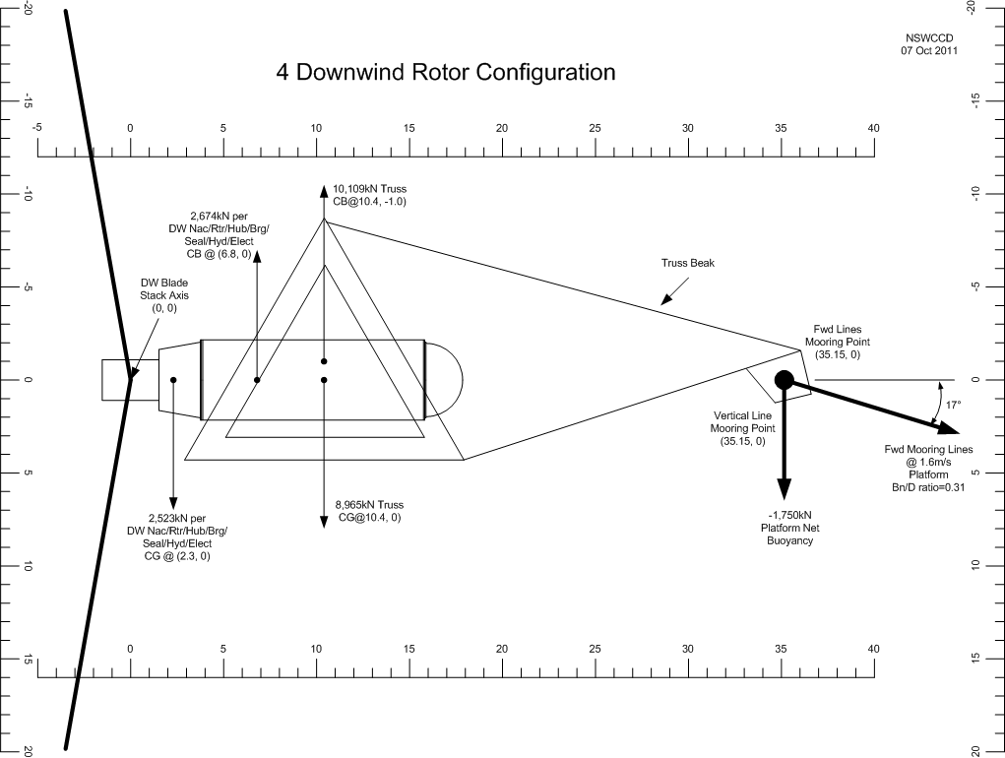
Platform Stability
Mooring Point Locations Required 4 Downwind Rotors
Notes:
Vertical and fwd mooring lines are co-located at a single point. This provides good weather-vaning capability.
At 0 current, pitch angle is ~ +2° due to weight of fwd mooring lines (line angle ~25°) and vertical mooring line angle is ~75° (platform moves fwd ~75m).
Pitch angle at 1.6m/s flow is 0° (nom. operating).
In-water hang angle is -90° (rotor blades down) with no fwd or vertical lines attached.
At higher currents (>1.6m/s) the platform pitch stays at 0°; however, the drag increases, fwd cable angle approaches 11° and platform seeks a lower depth to find slower current speed.
  Undoubtedly stable due to center of drag located so far aft of mooring point.

Slide 19
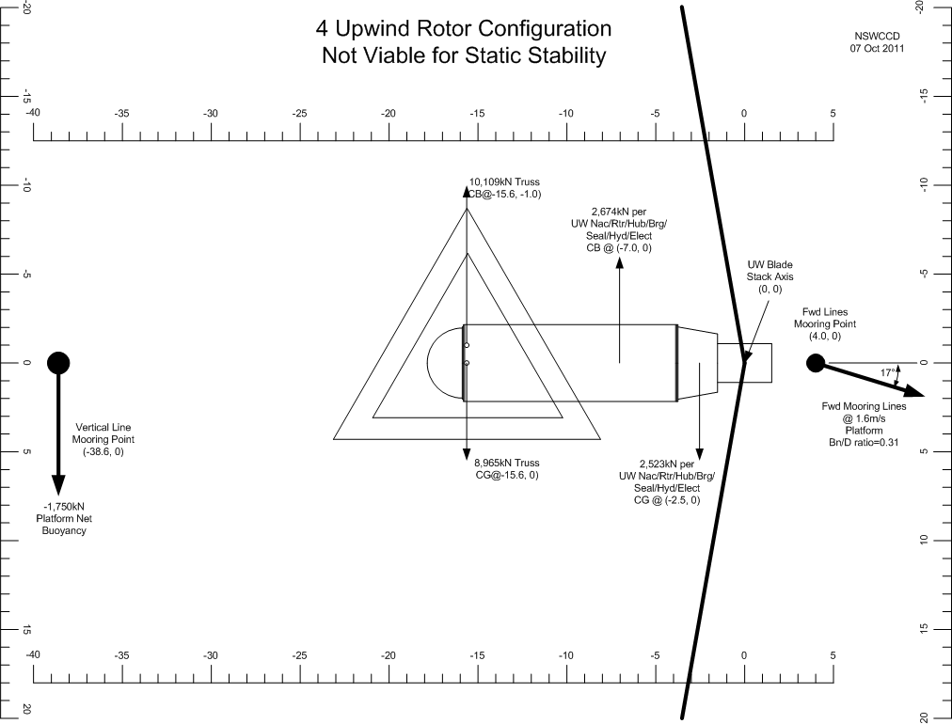
Platform Stability
Mooring Point Locations Required for 4 Upwind Rotors
Notes:
Vertical and fwd mooring lines are separated by ~43m. This does NOT provide good weathervaning capability and causes adverse roll/pitch /yaw coupled motions.
At 0 current, pitch angle is ~ +4° (nose dn) due to weight of fwd mooring lines (line angle ~25°) and vertical mooring line angle is ~85° (platform moves fwd ~15m).
Pitch angle at 1.6m/s flow is 0° (nom. operating).
In-water hang angle is +90° (rotor blades down) with no fwd or vertical lines attached.
At higher currents (>1.6m/s) the platform pitch stays at 0°; however, the drag increases, fwd cable angle approaches 11° and platform seeks a lower depth to find slower current speed.

Slide 20
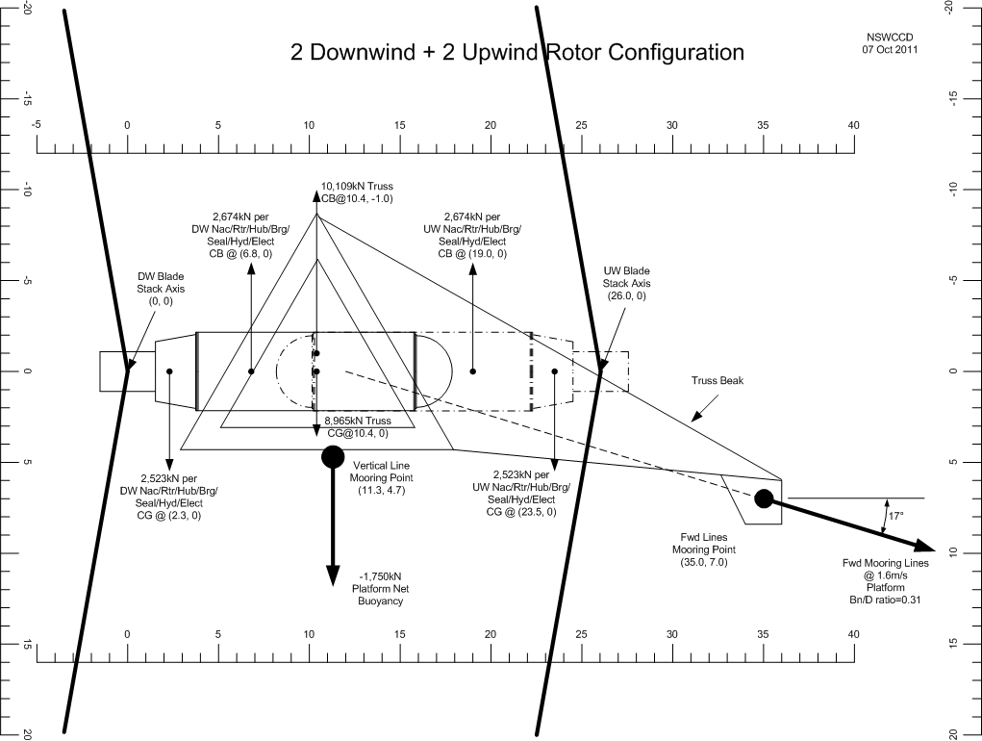
Platform Stability
Hydrostatic Stability – 2DW2UW Rotor Platform
Notes:
At 0 current, pitch angle is -6° due to weight of fwd mooring lines (line angle ~25°) and vertical mooring line angle is ~75° (platform moves fwd ~75m).
Pitch angle at 1.6m/s flow is 0° (nom. operating).
In-water hang angle is within ±5° of level with no fwd or vertical lines attached.
At higher currents (>1.6m/s) the platform pitches nose down, the drag increases, fwd cable angle approaches 11° and platform seeks a lower depth to find slower current speed.
  Undoubtedly hydrostatically stable.

Slide 21
Platform Stability
Hydrostatic Stability – 2DW2UW Rotor Platform
  Two (2) Upwind and two (2) downwind rotors
  Overall weight 19,100 kN
  Overall buoyancy 20,800 kN
  Fwd mooring lines towpoint is +35 m from aft rotor reference point (intersection of rotor stacking axis and shaft centerline) for stability with rotors stopped
  Vertical mooring line to limit platform rising in water column during low flow conditions

Slide 22
Dynamic Stability
Dynamic Stability – 2DW2UW Rotor Platform
Platform Diving to Reduce Loads
  C-Plane will dive to evade high currents
  Diving/rising depends on mean current strength
    Higher currents (than design) result in diving platform
    Lower currents result in rising platform (limited by vertical mooring line)
  Diving also depends, to a lesser degree, on the current shear
  Following slide shows ideal current profiles used in following simulations

Slide 23
Dynamic Stability
Dynamic Stability – 2DW2UW Rotor Platform
Shear Used
  Six ideal flow contours used in the following slides
  Should be considered together with simulations in measured currents
  Except as noted, simulations use ‘1.6 Shear’
Notes:
ALL OF THESE ARE IDEALIZATIONS MADE TO SIMPLIFY THE COMPLEX FLOW FOR PURPOSES OF UNDERSTANDING THE SIMULATION RESULTS

Slide 24
Dynamic Stability
Dynamic Stability – 2DW2UW Rotor Platform
Flow Shear Effects on Diving
  Shear flow does not have same effect as on the all-downwind design which had larger pitching motions
Notes:
Simulation starts at T=10,000 s after 10,000 seconds of initialization sequences. Each 14,000 second simulations takes ~15 seconds of clock time.

Slide 25
Dynamic Stability
Dynamic Stability – 2DW2UW Rotor Platform
Ideal Case of Uniform Flow
  Impossible-to-achieve ideal uniform flow of 2.4 m/s results in diving below the sea-floor mooring point

Slide 26
Dynamic Stability
Dynamic Stability – 2DW2UW Rotor Platform
Flow Shear Effects on Diving
  Ideal shear shows diving from 75 m to ~140 m and little increase in UCB2 ( velocity of flow at Rotor 2 axis)

Slide 27
Dynamic Stability
Dynamic Stability – 2DW2UW Rotor Platform
Flow Shear Effects on Diving – Step Change
  Ideal shear shows 10 m depth increase in 100 seconds due to a step change in currents

Slide 28
Dynamic Stability
Dynamic Stability – 2DW2UW Rotor Platform
Flow Shear Effects on Diving
  Ideal reverse-shear results in a huge dive, and significant increase in UCB2 (velocity of flow at Rotor 2 axis) if the flow can reach 2.4 m/s below design depth (highly unlikely)

Slide 29
Dynamic Stability
Dynamic Stability – 2DW2UW Rotor Platform
Flow Direction Change
  Ideal change in flow from 0° to +70°, with no reduction in flow speed or shear.
  Yaw angle does not change significantly (8°).
  A large lateral offset results (-150m).

Slide 30
Dynamic Stability
Dynamic Stability – 2DW2UW Rotor Platform
Wave Effects – Head Seas
  Hurricane size wave (12m Hs) can cause large motions and tension spikes on forward mooring line(s)

Slide 31
Dynamic Stability
Dynamic Stability – 2DW2UW Rotor Platform
Wave Effects – Head Seas
  Effects of 7 m waves will be much smaller

Slide 32
Dynamic Stability
Dynamic Stability – 2DW2UW Rotor Platform
Wave Effects – Beam Seas
  Effects of 7 m waves in beam seas will be smaller still

Slide 33
Dynamic Stability
Dynamic Stability – 2DW2UW Rotor Platform
Conclusions
  Undoubtedly hydrostatically stable with vertical line attached, with trim near zero pitch
  Undoubtedly will dive to evade higher currents in most if not all conditions
    Outlier conditions, of high currents and reverse shear requre further study and is a risk area
  Changing flow directions, at this point, is a risk in stability area
    Four (4) rotor model of platform can handle this effect for most conditions
    Examination of potential outlier conditions needs to be done
    Fallback is to install tails or other devices to increase stability
    Changing flow directions should be considered for basin test
  Simulations in waves show the following
    Storm waves in head (and following) seas can cause high pitch values and requires further study
    7 m SWH head seas waves appears to result in acceptable forward mooring line tensions
    7 m SWH beam seas results in much less motion in this model (which has no truss)
  Complete hydrodynamic stability for all flows measured to date appears, achievable, but has not been demonstrated in numerical simulations to date
  Stability without rotors turning, and lateral plane motions in general, are risks
  Motion based loads require further study
Notes:
7 m SWH HAS <6% CHANCE OF OCCURRING IN OPEN NOTHERN HEMISPHERE

Slide 34
Platform Weights & Centers
2-UW / 2_DW Rotor Configuration
Weight (dry): 19,056kN (1,945mt) Net Buoyancy: -1,750kN (178mt)

Slide 35
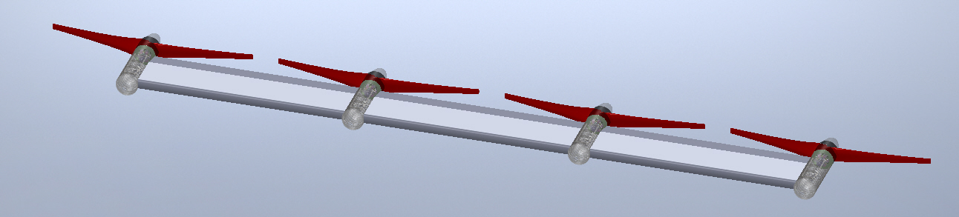
Configurations Considered
Pros
  Less vertical reach to towpoint
Cons
  Complex bending load transfer through nacelles
  Provides low CG/CB separation

Slide 36
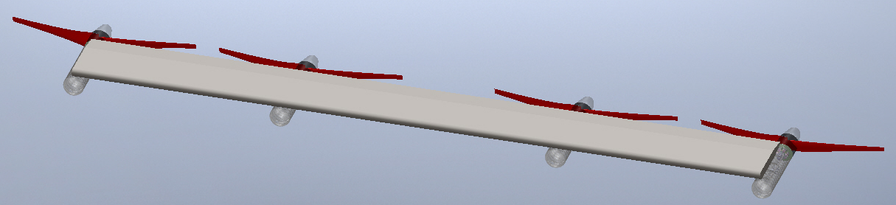
Configurations Considered
Pros
  Buoyancy above nacelles increasing CG/CB separation
  Rotor blades pass through the wing wake sequentially along the span
Cons
  High torsional deflections
  Large vertical reach to towpoint
  Rotor drag produces high torsional moments

Slide 37
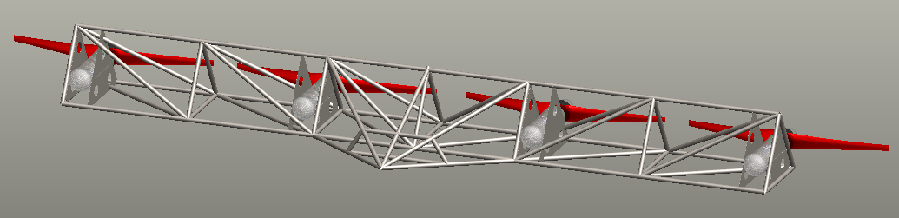
Configurations Considered
Pros
  Vertical and forward mooring lines are at same location
  Towpoint ahead of rotor drag providing high hydrodynamic stability
Cons
  In-water hang angle 90º nose up
    Requires large fwd mounted weights to achieve 0° static pitch trim
  All blades are influenced by wake deficit

Slide 38
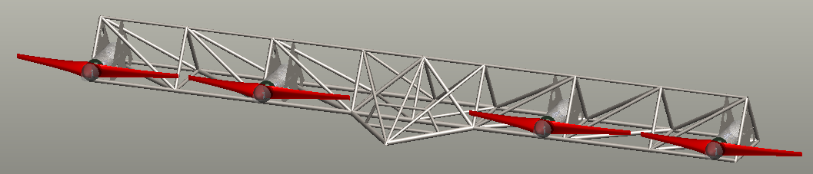
Configurations Considered
Pros
  All rotors are up-wind of truss
Cons
  In-water hang angle is 90º nose down
    Requires large fwd mounted weights to achieve 0° static pitch trim
  Vertical and forward mooring lines have large separation distance
  Towpoint and center of drag are close resulting in lower hydrodynamic stability

Slide 39
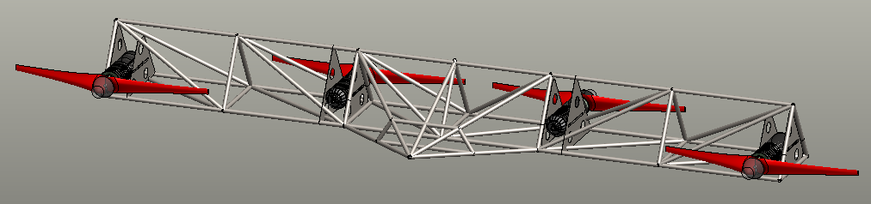
Configurations Considered
Pros
  In-water hang angle is near 0º
    No additional weights required for 0° static pitch trim
  2 rotors are upwind
  Static balance point near center of truss
Cons
  DW rotor susceptible to wake deficit
  Bearing thrust load is different between UW and DW nacelles

Slide 40
Wing and Truss Comparison
Wing Design
Pros
  Low drag
  Low wake
  Aesthetically appealing
  Tailored for directional lift (if REQ’D)
Cons
  Structurally complex
  Changes lift as a function of flow angles (turbulence & waves)
  Flexible in torsion due to low height-to-span ratio
  Heavy
  High fabrication cost
Truss Design
Pros
  Standard tubular pipe members
  Ease of fabrication and nacelle attachment
  Buoyancy can be tailored
  Structurally adequate (bending and torsion)
  Less susceptible to flow angle changes
  Lower weight
  Lower fabrication cost
Cons
  Introduced wake deficit into DW rotors (fatigue & power)
  Increases total system drag

Slide 41
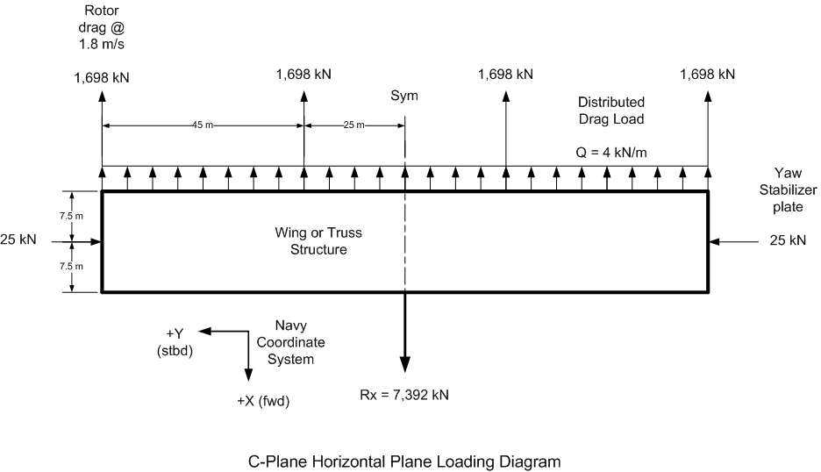
Platform Structural Forces
Structural Loads in X-Y Plane
Rotor Rotation
CCW
Rotor Rotation
CW
Rotor Rotation
CCW
Rotor Rotation
CW
Rotor Drag @ 1.8m/s

Slide 42
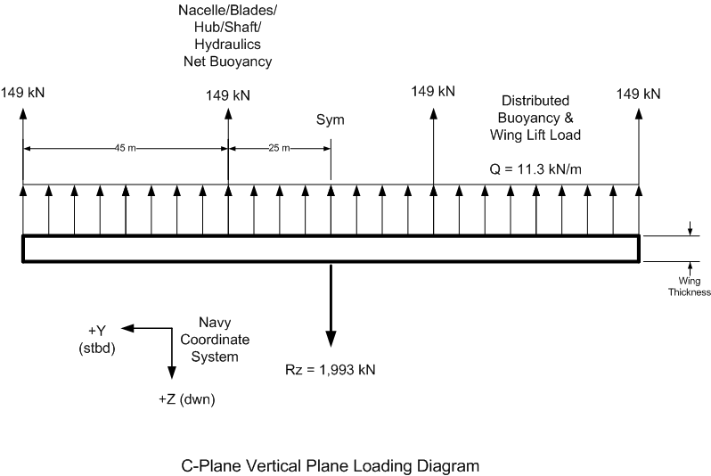
Platform Structural Forces
Structural Loads in Y-Z Plane

Slide 43
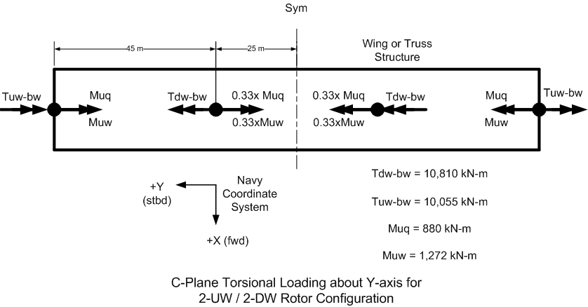
Platform Structural Forces
Torsional Loads on Truss for 2-UW / 2-DW Rotors
(Nacelle/Rotor aligned with Truss Centroid)
(Nacelle Buoyancy & Weight Moments)
(Hydrodynamic Shear Flow Moments)

Slide 44
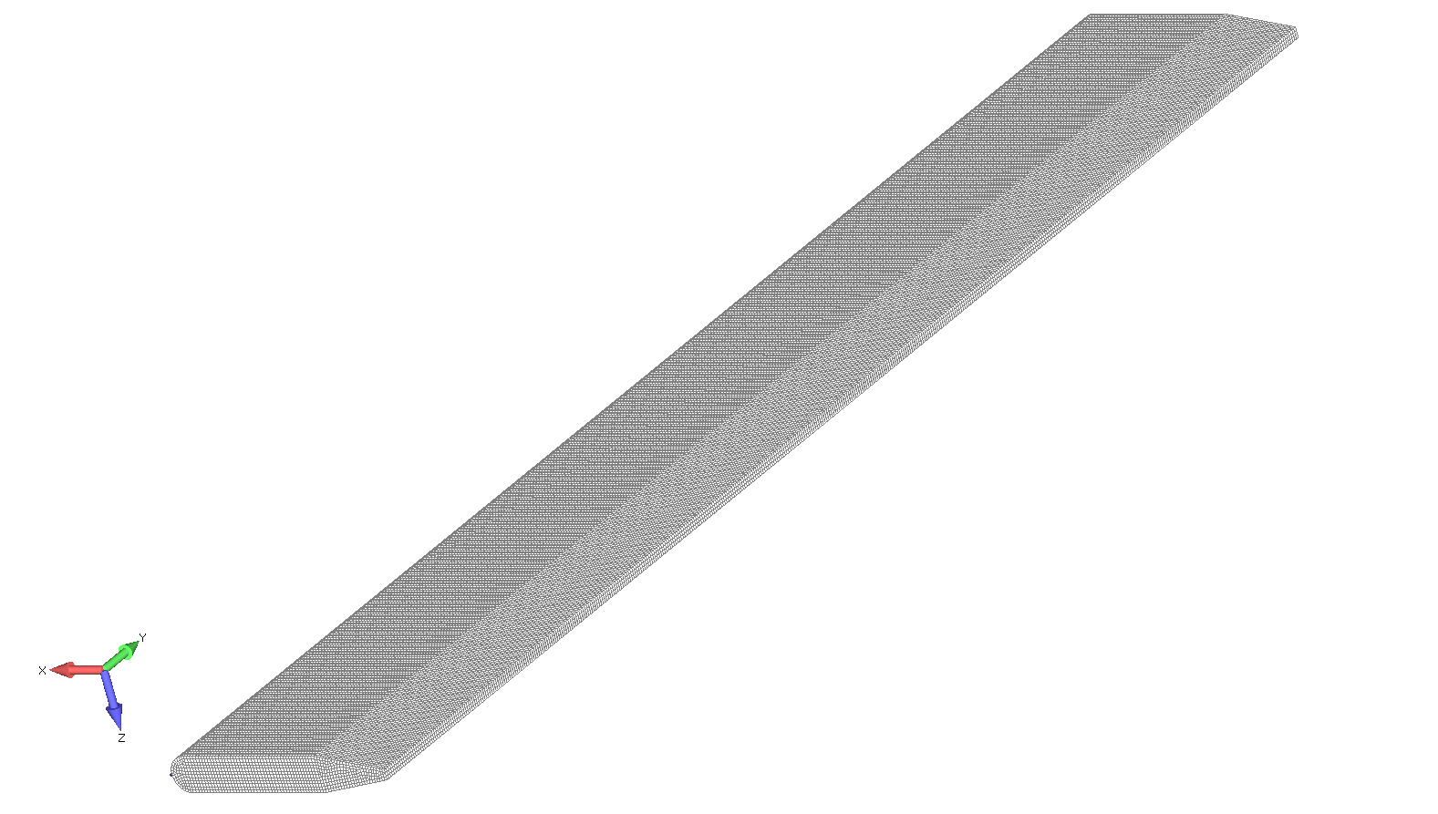
Wing Structural Analysis
Wing Model
75m
25m
25m
25m
beams
Symmetry
bulkheads
(stbd) +Y
+X (fwd)
Mesh Size: 0.15m
Nodes: 122,089
Elements: 126,490
Weight: 8,667,263 N
1,948,478 lbs
*half of the wing

Slide 45
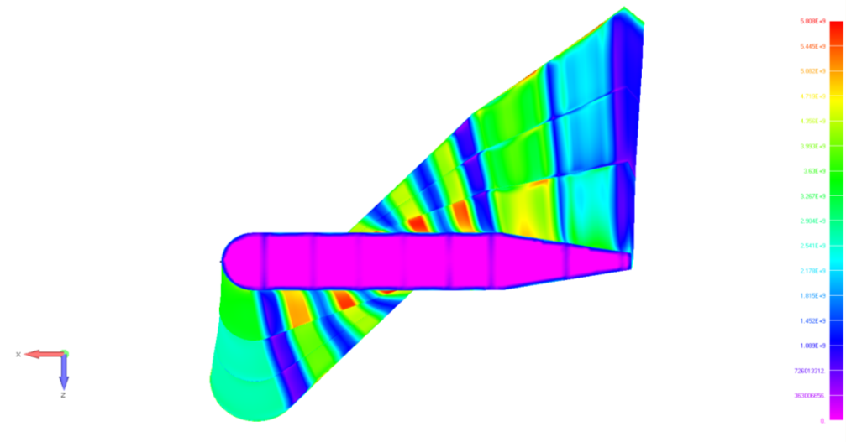
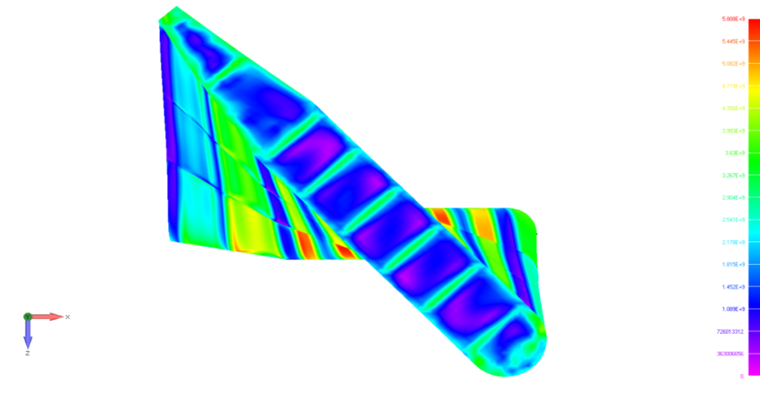
Wing Structural Analysis
Wing Deflection & Stresses (Very High)
(Analysis values need to be rechecked, do not correlate with hand calculations or Solidworks analysis)
Max deformation: 7.64m
Center to Starboard
Max prin. stress: 9.18GPa
Starboard to Center
+X (fwd)
+X (fwd)
Notes:
Rotor torque loading contributes to most of the wings deformation
~6GPa principle stress on panels due to hydrostatic pressure (300psi)
+Z (dwn)
+Z (dwn)
**ALL CONTOURS IN VON MISES**
**ACTUAL DEFORMATION SCALE**

Slide 46
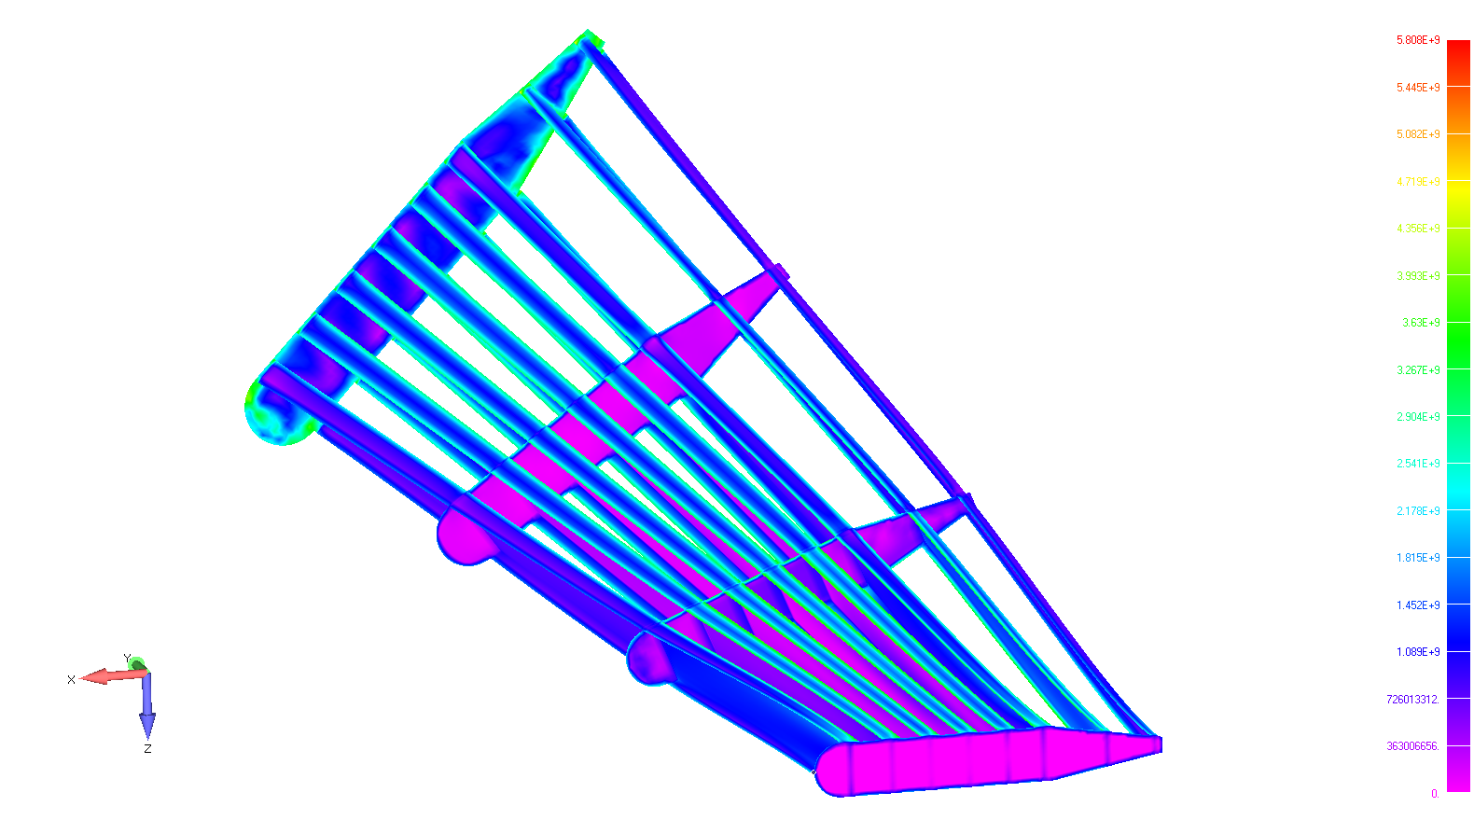
Wing Structural Analysis
Wing Internal Structure Stresses (Very High)

Slide 47
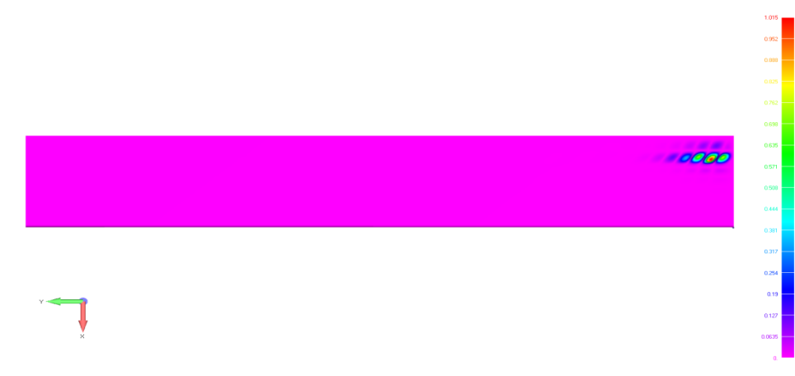
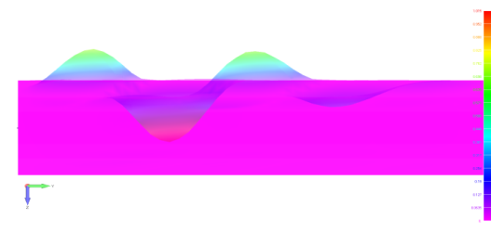
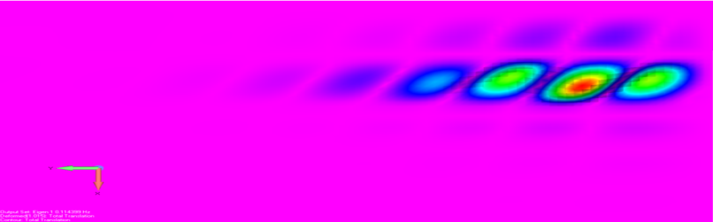
Wing Structural Analysis
Buckling Analysis
Symmetry
beams
bulkheads
The panels colored in red have the propensity to buckle
symmetry plane
+Y (stbd)
+X (fwd)

Slide 48
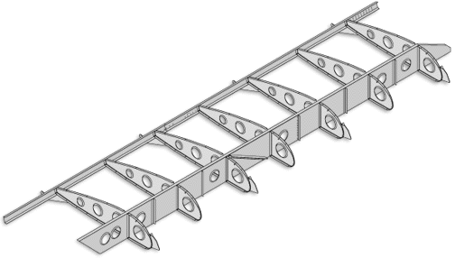
Wing Structural Analysis
Recommendations
Add additional support to resist torque loading
  Stiffeners running diagonally from corner to corner
Holes on bulkheads and beams to
reduce weight while still maintaining
structural integrity
Reduce beam spacing in aft portion of wing to prevent panel buckling
  Add additional beam
  Distribute beams evenly space

Slide 49
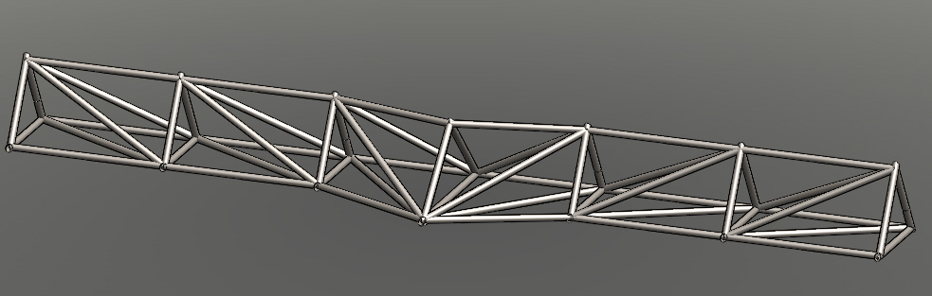
Truss Loading
Overall length: 155 m
Pipe Diameter: All 1.22 m
Weight: 1,022,382 kg
Estimated cost: $3.37 million ($3.3/kg)

Slide 50
Truss Structural Analysis
Allowable Stress Value
Truss material: Welded pipe per API51 X56
  Yield Strength: 386.1 Mpa (56,000 psi)
Knockdown for manufacturing: 20%
  Yield Strength: 308.9 Mpa (44,800 psi)
Factor of Safety (FOS): 3 on Yield @1.8 m/s loads
  Allowance for dynamic loading, weld knock-down, and corrosion
Allowable yield stress: 102 Mpa (14,800 psi)
Allowable shear stress: 0.577 (allowable yield stress): 59 Mpa (8,600 psi)
Poisson's ratio: 0.3

Slide 51
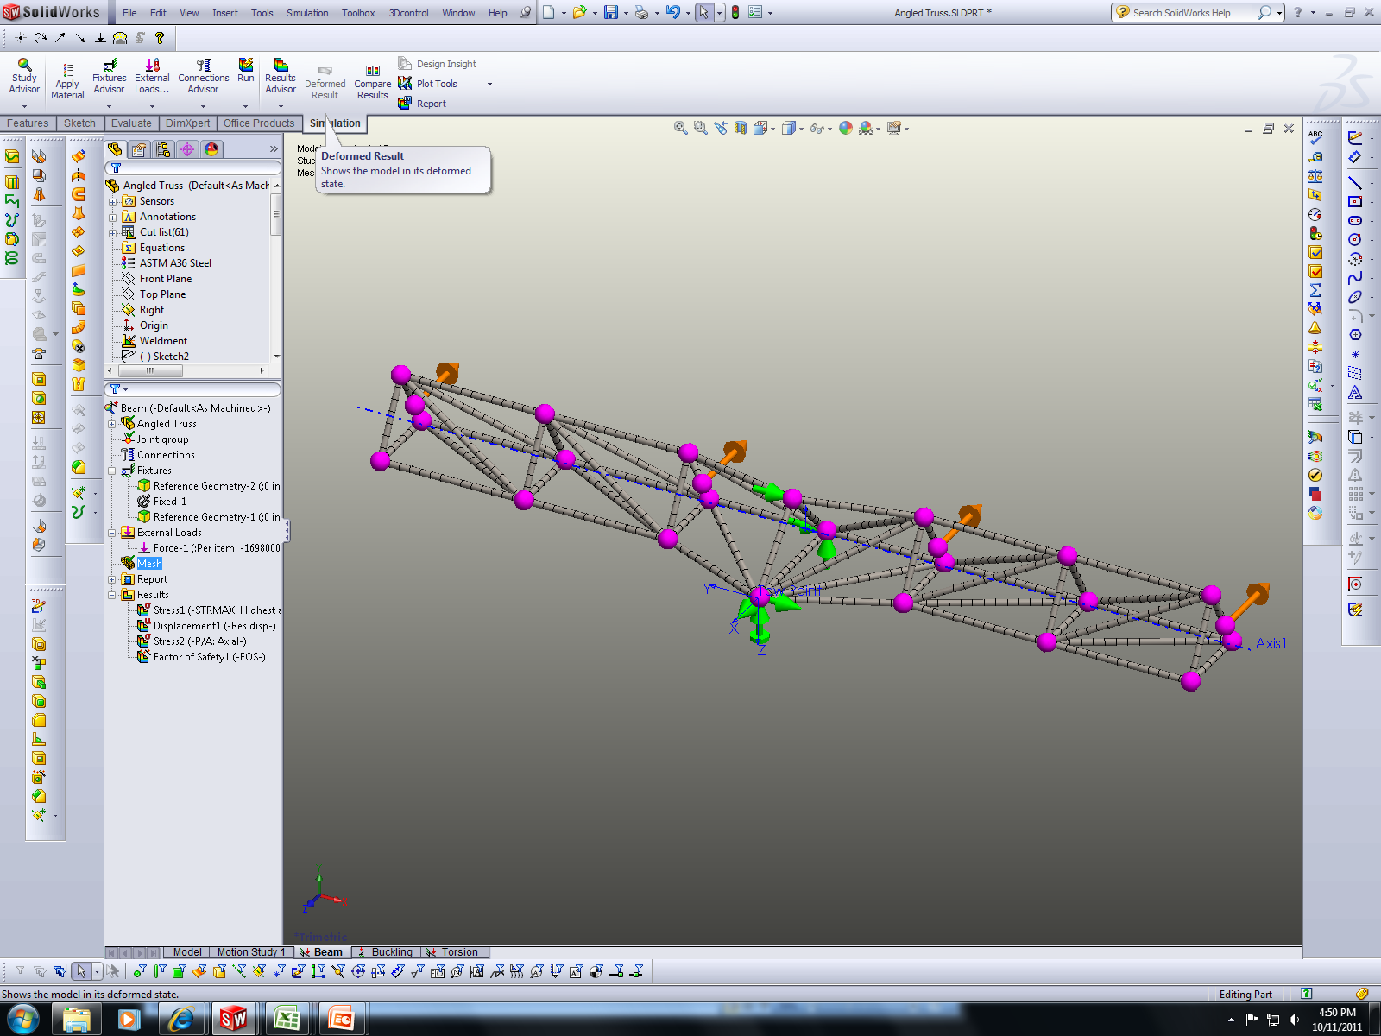
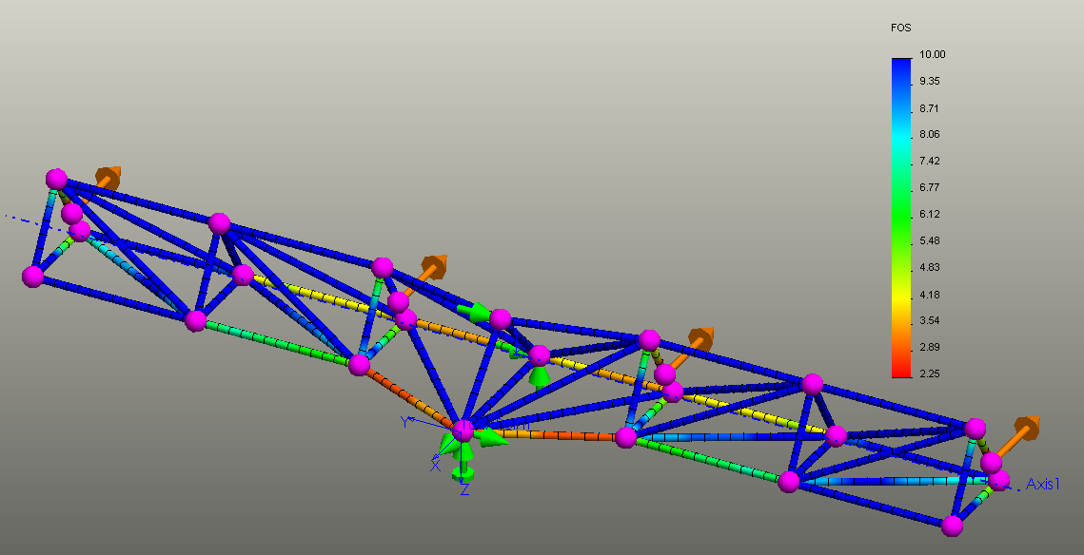
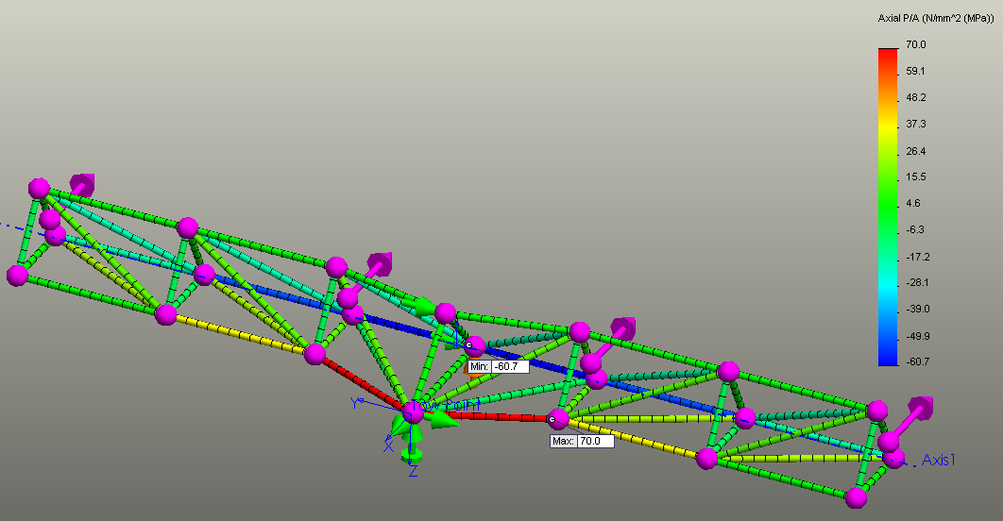
Initial Truss loading
Each member was comprised of beam elements
Only Drag load from rotors was applied (1,698 kN @1.8 m/s)
Several members exceeded a SF of 10

Slide 52
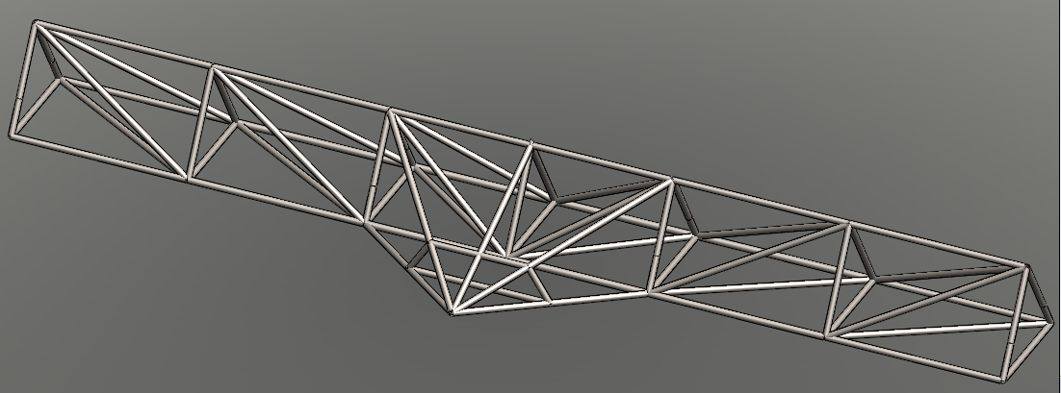
Semi-Optimized Truss Loading
Overall length: 140 m
Pipe Diameter: Average 0.86 m
Weight: 758,978 kg
Estimated cost: $2.50 million ($3.3/kg)

Slide 53
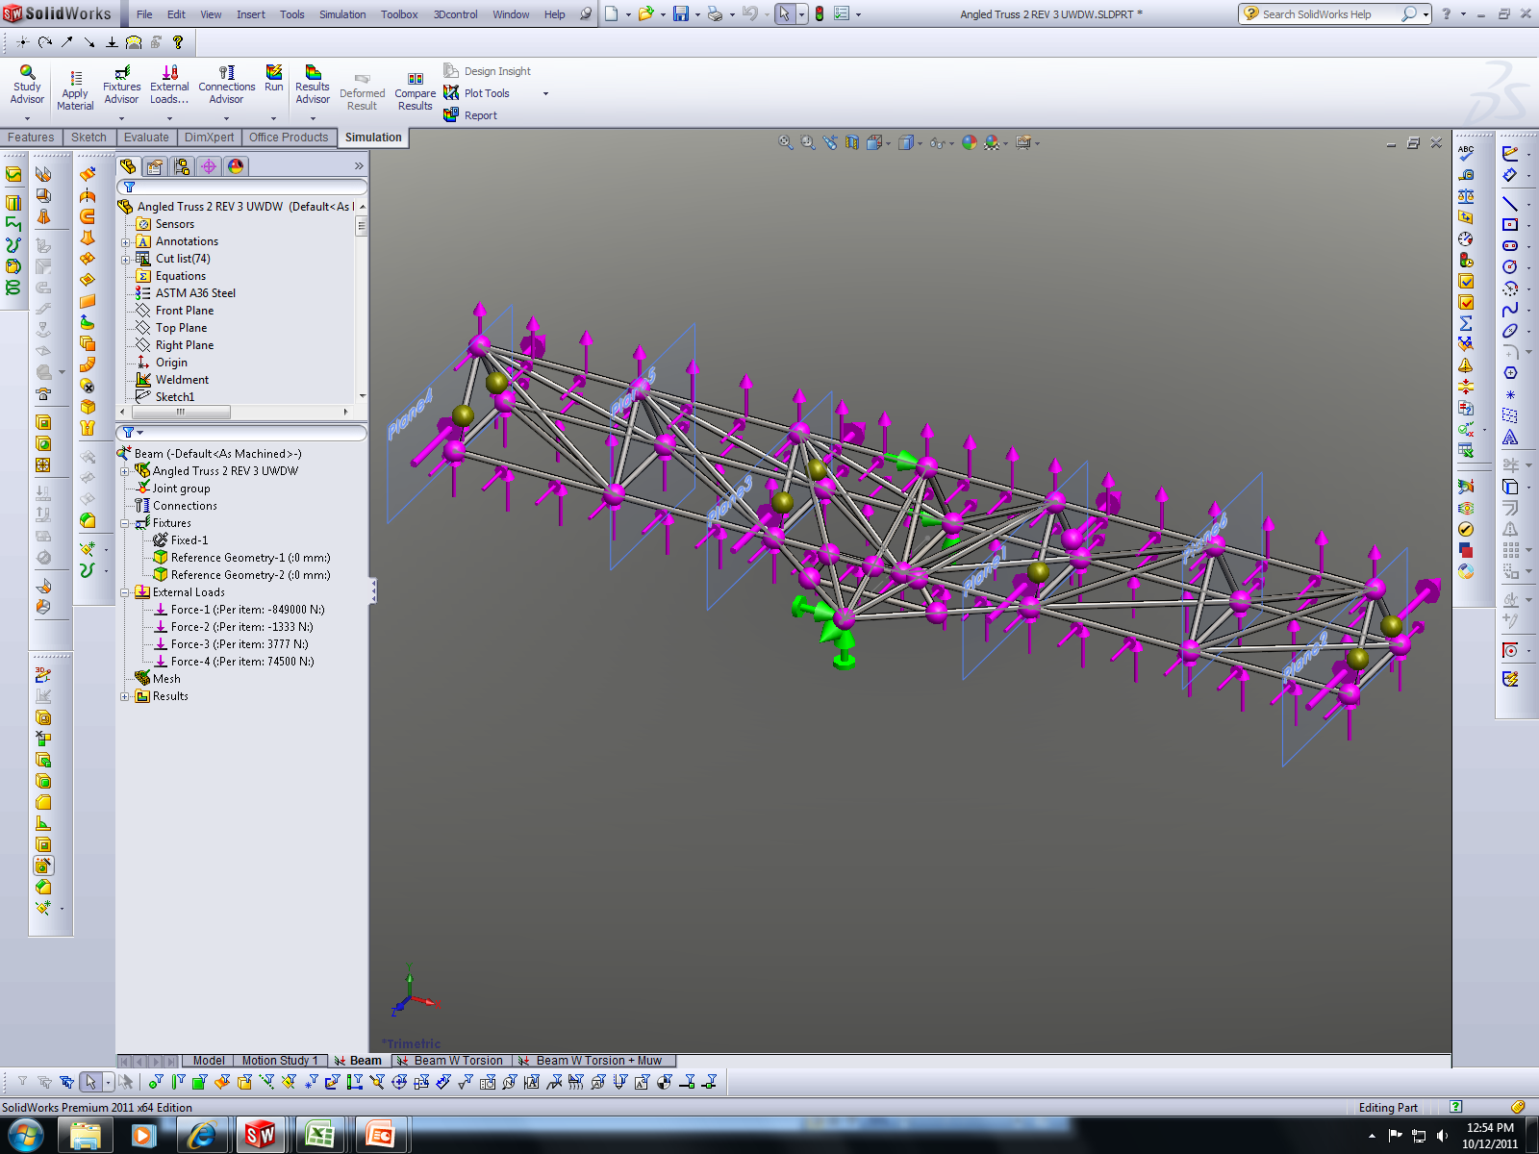
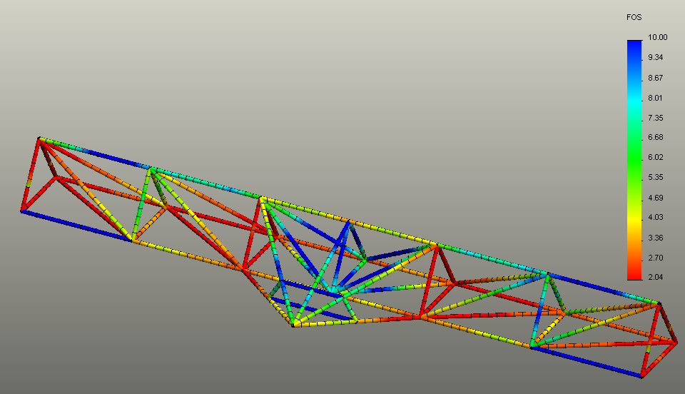
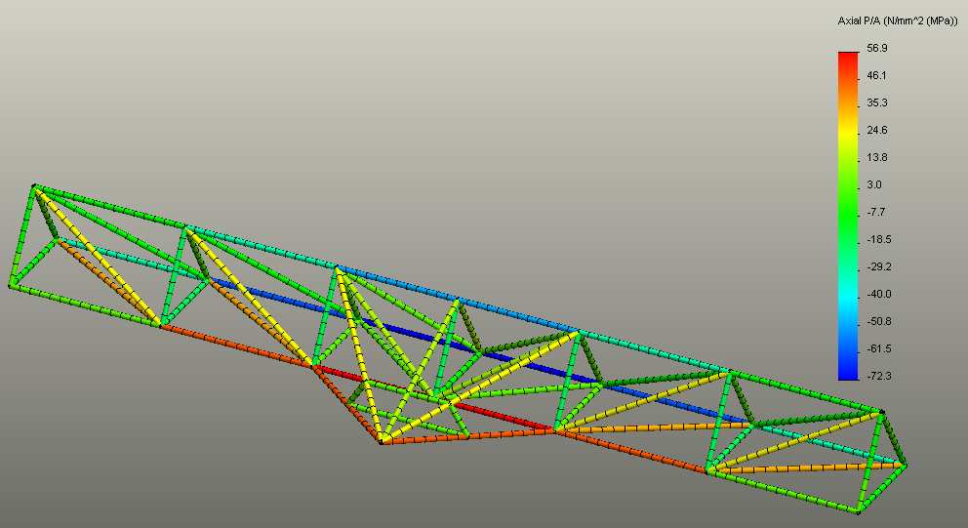
Semi-Optimized Truss
Most members were reduced to 0.86 m
Loads applied
  drag (rotor & platform),
  buoyancy (nacelle & truss)

Slide 54
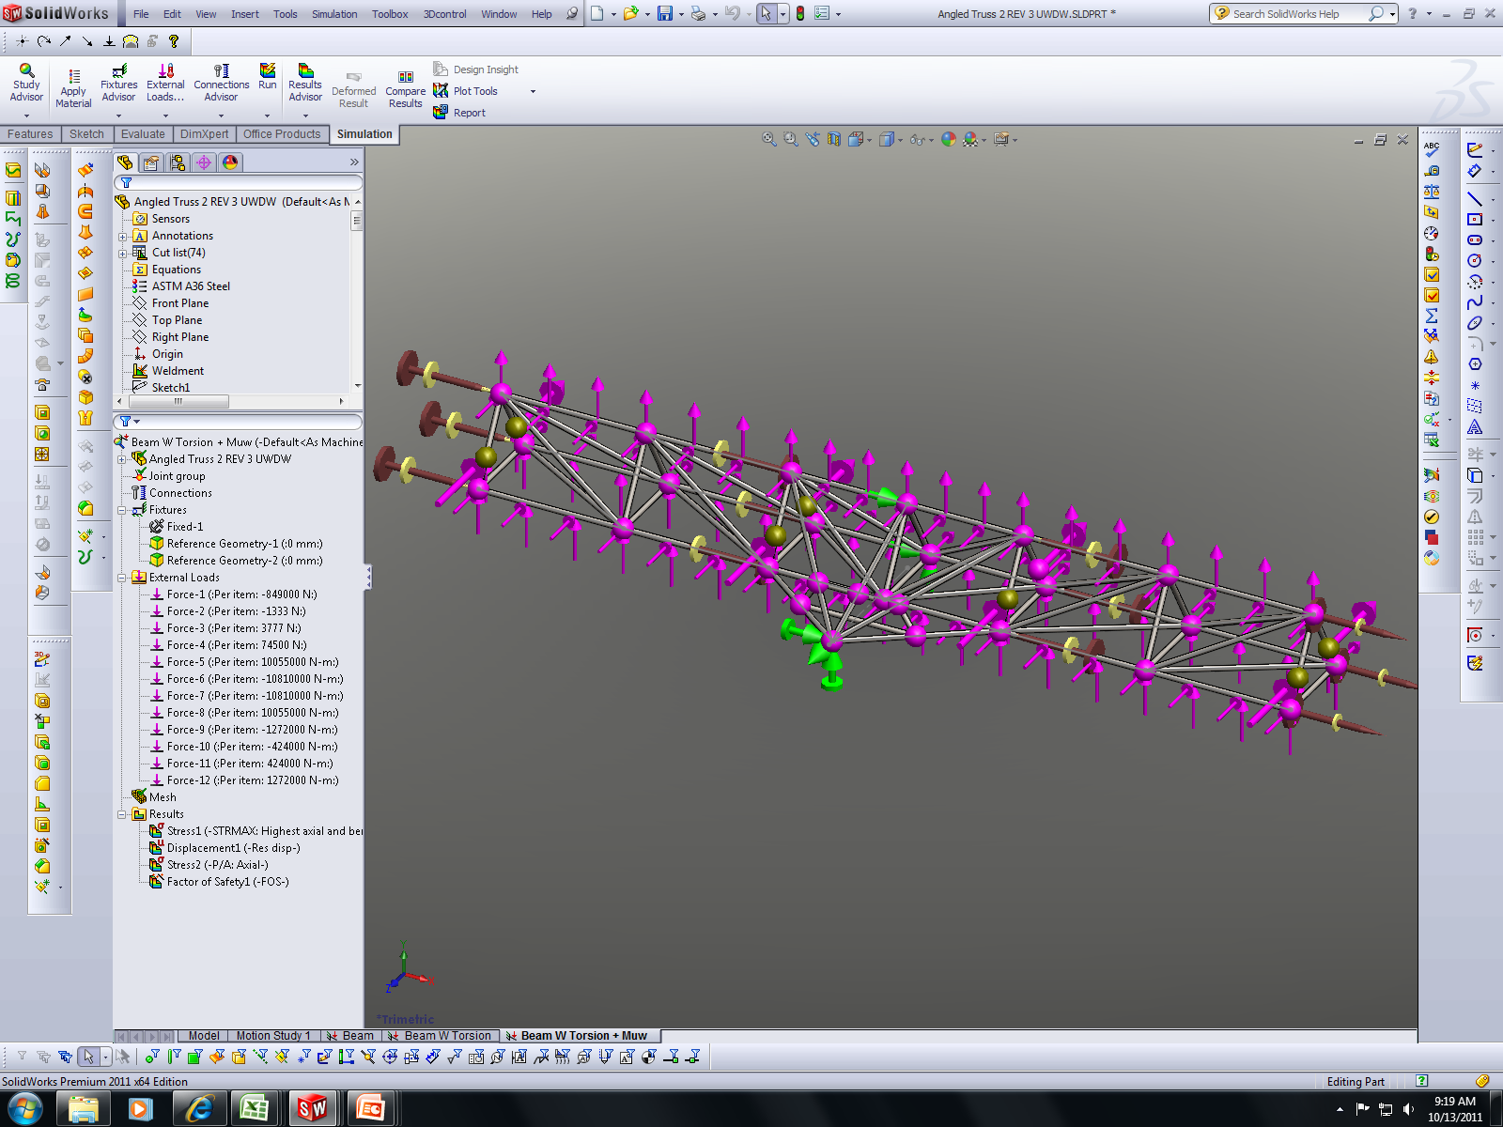
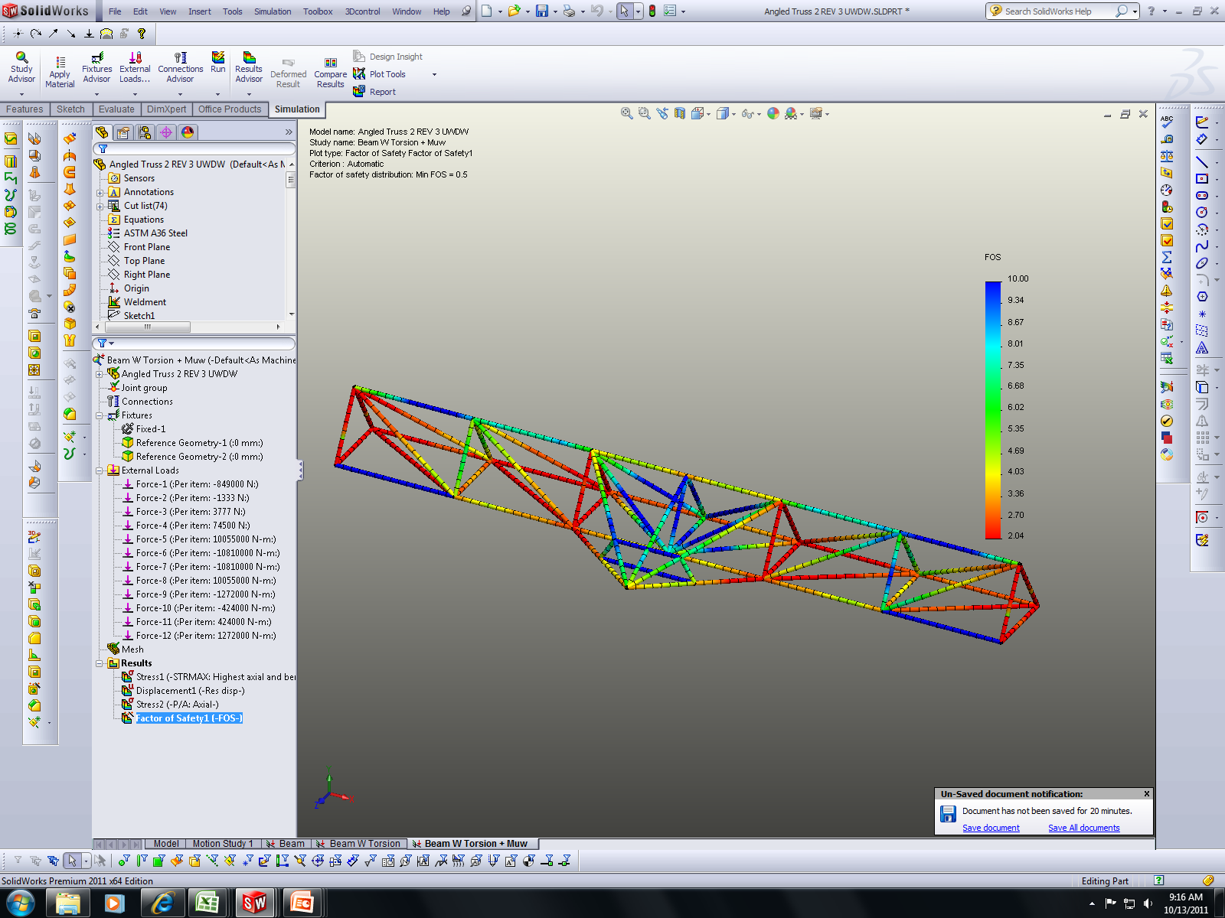
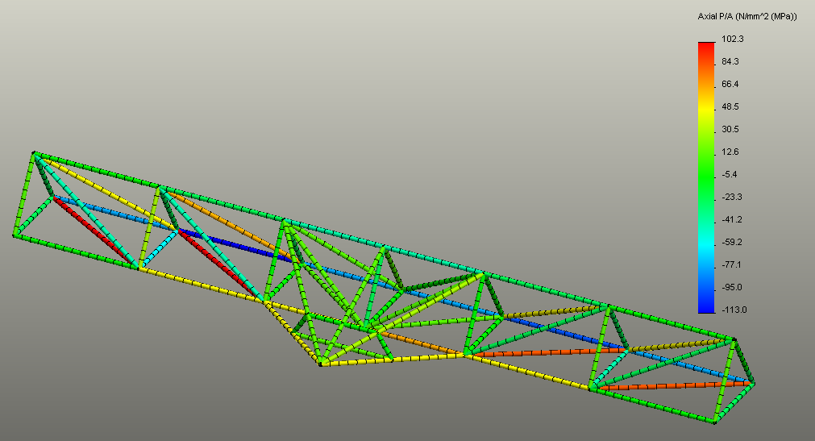
Semi-Optimized Truss
Loads applied:
  drag (rotor & platform)
  buoyancy (nacelle & truss)
  Torque (static, hydrodynamic)

Slide 55
Effect of Safety Factor Reduction
Current configuration
  Pipe: Dia 0.86m x 25mm wall
  SF=3 on Stress
  SF=1.72 on Hydrostatic Buckling
  Wair = 525kg/m
  Wswater = -74kg/m
Scenario 1: Constant wall thickness
  Pipe Dia 0.66m x 25mm
  SF=1.5 on Stress
  SF=3 on Hydrostatic Buckling
  Wair = 397kg/m
  Wswater = 46kg/m
Scenario 2: Reduce wall to 19mm
  Pipe Dia 0.71m x 19mm
  SF=1.5 on Stress
  SF=1.39 on Hydrostatic Buckling
  Wair = 324kg/m
  Wswater = -82kg/m
Dia 0.71m x 19mm wall
Weight Air: 445,000kg
Buoyancy:
Available: 112,300kg
REQ’D: 117,250kg
Cost: $1.47M dollars
Dia 0.76m x 19mm wall
Weight Air: 476,270kg
Buoyancy:
Available: 161,250kg
REQ’D: 117,250kg
Cost: $1.58M dollars
SF=2.2 on stress and 1.19 on Buckling
Dia 0.86m x 25mm wall
Weight Air: 716,700kg
Buoyancy
Available: 102,058kg
REQ’D: 117,250kg
Cost: $2.37M dollars
Additional Buoyancy REQ’D
Additional Buoyancy REQ’D
Viable Solution with cost reduction of $790,000 Dollars

Slide 56
Summary and Future Analysis
Summary
  Cost has been reduced from $3.7M (baseline) to $2.5M (semi-optimized)
  Further cost reductions to $1.6M by reducing Factor of Safety (3.0 to 1.5 on stress)
  Weight reduction from 1,000,000kg to 760,000kg, with potential to 480,000kg (FoS reduction)
Future Analysis
  Evaluate torsional loads
  Incorporate nacelle attachments into model
  Perform detailed buckling calculation with hydrostatic pressures
  Perform fatigue & modal analysis

Slide 57
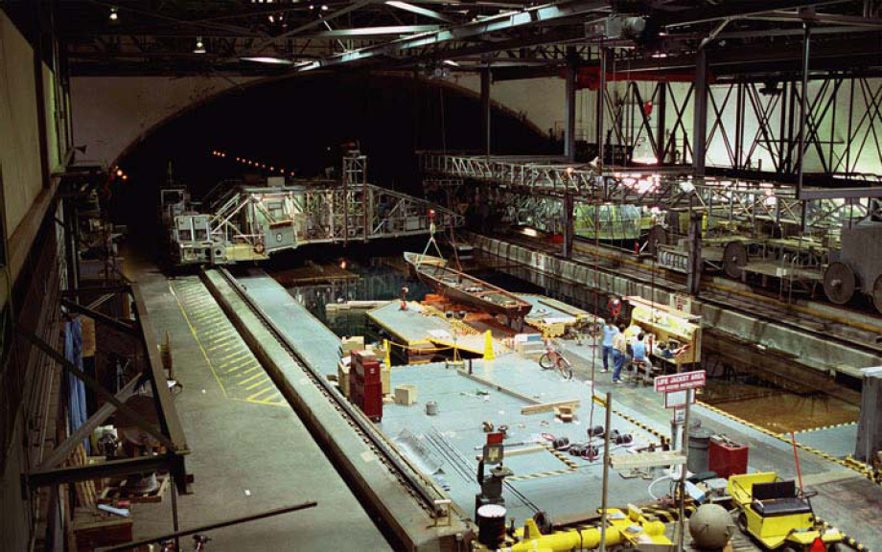
Technical Risk Reduction
Scale Model Testing
  In order to mitigate the technical risk level (TRL) of the C-Plane hydrodynamic stability from a TRL=7 to a TRL=3, model testing of a geometric similar model of scale factor 1/25 is planned for the 2nd quarter of CY2012 in the Deep Water Basin facility at the NSWCCD, Bethesda, MD.
  The Basin has dimensions of :
      Width: 15.5m (51 ft)
      Depth: 6.7m (22 ft)
      Length: 575m (1,886 ft)
      Tow Carriage Speed: 10m/s (19 knots)

Slide 58
Technical Risk Reduction
Scale Model Testing
  1/25-scale Model Characteristics
    Rotor diameter: 1.60m (5.25 ft)
    Nacelle diameter: 0.17m (0.56 ft)
    Nacelle length: 0.66m (2.16 ft)
    Support Structure - Truss
      Length: 5.60m (18.4 ft)
      Width: 0.60m (2.0 ft)
      Height: 0.52m (1.71 ft)
    Weight (dry): 1.22kN (274 lb)
    Net Buoyancy: 0.11kN (25.2 lb)

Slide 59
Technical Risk Reduction
Model Test Scaling Effects
  The Navy routinely tests ship and submarine models in the 1/20th- to 1/30th-scale factor range with reliable and accurate full-scale correlation
  Froude scaling is the correct scaling approach in which gravitational effects (platform weight and buoyancy) are major contributors to the characteristics that control stability.
    Froude scaling laws dictate the following scaling factors (λ=1/25 of full scale)
    Linear properties (length, area, volume) scale according to the linear property to the exponent factor (length = λ¹, area = λ², volume = λ³)
    Mass and force properties scale as the cube of the scale factor (λ³ )
      Test measured forces would be multiplied by 15,625 to determine full-scale forces
    Velocity scales as the square root of the factor (λ^{1/2} )
      Model scale current speeds are 1/5 of full scale (1.6m/s = 0.32m/s model)
    Time scales as one over the square root of the factor (λ^{-1/2} )
      Measured response times are 5 times faster than full scale responses

Slide 60
Technical Risk Reduction
Model Test Reynold’s Number Scaling Effects
  Rotor blade forces are predominantly fluid momentum dominated effects (hydrodynamic or aerodynamic forces) and are typically scaled by matching the Reynold’s number of the component
  Rn = VL/ν
    where V is the velocity in ft/s
    L is the characteristic length in ft
    ν is the kinematic viscosity of the fluid in ft²/s
  Rn = 2.87E7 for full scale rotor blade tip with TSR = 10
  Rn = 2.79E4 for the Froude scaled rotor blade tip
  Thus, the model scale rotor blade hydrodynamic generated forces may not scale correctly since the ratio in Rn values is a factor of 1,000. This could change the lift and drag coefficient values that are based on Rn effects. These differences in measured rotor lift and drag forces could effect the platform stability since rotor drag is a major contributor to the overall platform force.

Slide 61
Technical Risk Reduction
Model Test Reynold’s Number Scaling Effects
  In order to obtain the correct drag force on the model the nacelle/rotor assembly will be equipped with a motor/tach/encoder that will power the rotor blades and accurately measure the rotor rpm.
  The nacelle/rotor assembly will be capture towed in the basin mounted to a force measuring sensor that will record the drag load of the assembly as a function of rotor blade rpm. The rpm that matches the scaled full-scale rotor drag force at the speed of interest will be used for the platform testing. This ensures the correct rotor drag forces will be exerted on the platform for stability evaluations.

Slide 62
Technical Risk Reduction
Scale Model Testing
  Tow tank testing scheduled for 23 April – 11 May 2012
  Testing consists of the following test scenarios:
    1. Single nacelle/rotor assembly drag calibration
    2. Captured model testing using build-up method
      Measure 6 DOF forces and moments of the platform using a pitch and yaw adjustable apparatus mounted on a submerged strut/sting
      Support Structure (Truss) only
      Truss + nacelles (4ea, no rotor blades)
      Truss + nacelles (4ea) + rotor blades (4 sets)
      Pitch angle variation -25° to +25°
      Yaw angle variation -40° to +40°

Slide 63
Technical Risk Reduction
Scale Model Testing
  Testing scenarios (cont’d):
    3. Free-towing of the C-Plane platform using a simulated mooring system
      Free-tow of the platform may be performed with the model inverted and the simulated mooring lines anchored to the underside of the tow carriage. Model ballasting and the effects of gravity and buoyancy will need to be investigated for feasibility for the inverted mode. With this test method changing the locations of the mooring lines would be simple and can simulate off-axis current directions.
      Free-tow of the upright platform using a framework protruding into the water to anchor the mooring lines. Gravity and buoyancy effects are acting in the proper manner for stability assessment. Performing off-axis test conditions may be more difficult.

Slide 64
Technical Risk Reduction
Scale Model Testing
  Data Analysis
    Forces and moment data obtained from testing will be used to predict the full scale forces and moments acting on the platform
    Forces and moments data plotted with respect to pitch and yaw angle will be used to compute hydrodynamic coefficients for comparison with analysis coefficients used to predict platform stability. Stability analyses will be recomputed using revised coefficients.
    Video from the free-tow testing will be reviewed for platform behavior indicating instability regions.
    Above data analysis will be used to feed design changes to the prior to Critical Design Review and reduce the TRL

Slide 65
Accomplishments and Results
Platform Static & Hydrodynamic Stability
Flightlab predicted rotor forces and moments results have confidently correlated with ARL rotor results to be able to use the rotorcraft code output for hydrodynamic coefficient generation.
DCAB software code has been modified to accept multiple bodies (multiple nacelles) and mooring lines for hydrodynamic analyses (with limited verification to test data).
A passive depth increasing platform (without use of a wing or control surfaces) has been preliminarily analyzed that seeks a slower current velocity when the local velocity exceeds 1.6m/s.
Preliminary structural analysis has been conducted on a Wing-shaped and Truss-shaped nacelle/rotor support structure with results favoring the truss structure
The Truss Support Structure has been structurally analyzed to reduce pipe member sizes in order to reduce weight and cost and capable of tailoring the structure to the net buoyancy requirements.

